Slide 1
Movie Recommendation System using Machine Learning
Submitted in the partial fulfillment for the award of the degree of
BACHELOR OF SCIENCE
IN
B.Sc. CSM (Computer Science , Statistics and Mathematics)
Submitted by:
Mohammad Umar
University ID: 22BNM20076
Under the Supervision of:
Shivani Kamboj
Department of Mathematics
DISCOVER . LEARN . EMPOWER

Slide 2
Outline
Project Identification
Need for the project
Objectives of the work
Conceptual Design and Methodology
Results and Outputs

Slide 3
Project Identification
Project Title & Introduction
Title: Movie Recommendation System
Introduction:
  A recommendation system that suggests movies based on user preferences.
  Unlike OTT-specific models, this system is platform-independent and adapts to new data updates.
  Implements advanced ML techniques for personalized recommendations.

Slide 4
Need for the Project
Why is it important ?
Users have accounts on multiple streaming platforms but get recommendations limited to each platform.
No unified system for recommending movies across different OTTs.
Helps users discover movies from different sources without bias towards a single platform.
Demonstrates practical ML implementation, reinforcing key learning in recommendation systems.

Slide 5
Objectives of the Work
Main Objective
Build a platform-independent recommendation system using ML models.
Improve recommendation accuracy by optimizing similarity measures and algorithms.
Ensure adaptability to new data for up-to-date recommendations.

Slide 6
Sub-Objectives
Data Handling: Process and clean large-scale movie datasets.
Model Selection: Experiment with collaborative filtering, content-based,
and hybrid models.
Performance Evaluation: Measure accuracy using RMSE, precision, recall,
and A/B testing.
Scalability: Ensure the system can handle growing data and user base

Slide 7
Innovation & Uniqueness
Unlike Netflix or Prime Video, this model is platform-independent.
Works with dynamic data updates to stay relevant.
Uses user-item interactions to improve predictions over time

Slide 8
Conceptual Design and Methodology
System Architecture:
User provides ratings or interactions.
Data is preprocessed, cleaned, and transformed into a user-item matrix.
KNN-based collaborative filtering or matrix factorization models predict
unseen ratings.
Final recommendations are presented to the user

Slide 9
Methodology Steps
Dataset Selection (MovieLens 20M dataset)
Data Preprocessing (Cleaning, handling missing values, encoding)
Exploratory Data Analysis (EDA)
Building Recommendation Models (Collaborative filtering, KNN, Matrix Factorization)
Evaluation & Optimization
Deploying the Model (Future Scope)

Slide 10
Dataset Selection
Data Preprocessing
Exploratory Data Analysis (EDA)
Building Recommendation Models
Evaluation & Optimization
Deploying the Model

Slide 11
Tools & Technologies Used
Programming Language: Python
Libraries: Pandas, NumPy, Scikit-Learn, Surprise
Dataset: MovieLens 20M
Models: KNN, Collaborative Filtering, Matrix Factorization

Slide 12
Results and Outputs:
Key Outcomes of the Project:
Successfully built a platform independent movie recommendation system .
Achieved completion of all key project goals as per initial roadmap.
Functional codebase tested and validated.
Visual insights generated from the dataset (ratings distribution, etc.).
Positive feedback from judges/panel.

Slide 13
Progress Against Original Plan
Task | Planned Timeline | Actual Completion | Remarks
Data Collection | Week 1 | Week 1 | ✅ On Track
Preprocessing | Week 1-2 | Week 2 | ⚠️ Slight delay (data cleaning)
Model Training | Week 2-3 | Week 3 | ✅ On Time
Evaluation & Visualization | Week 4 | Week 4 | ✅ Completed
Presentation Preparation | Week 5 | Week 5 | ✅ Done & Presented
All deliverables were met successfully with minimal deviation from the original plan.

Slide 14
Refinements in Approach
Initially considered simple statistical methods → shifted to more robust recommendation techniques.
Feature engineering: Reduced noise, handled missing values, filtered rare movies/users.
Optimized model parameters for better results.
Code efficiency improved using vectorization and concise plotting (e.g., using one-liners for visuals like df['rating'].hist()).

Slide 15
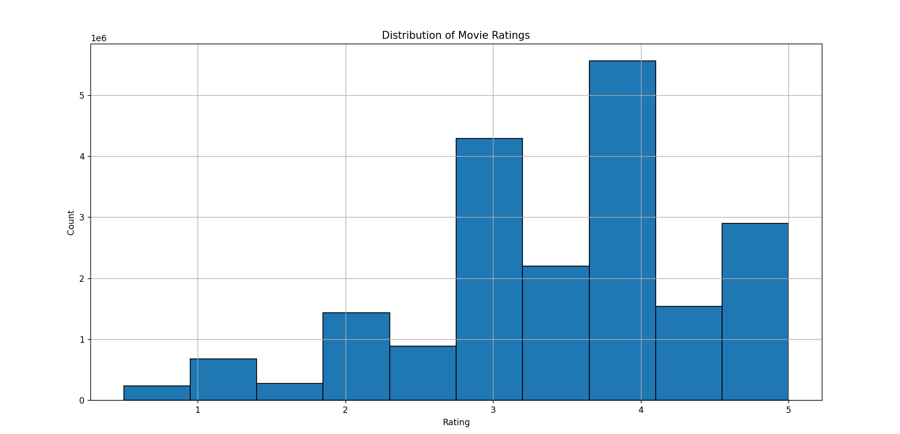
Ratings Distribution – User Behavior Insight :
“Distribution of Movie Ratings”
Most ratings clustered around 3.5–4.5, suggesting a bias toward positive reviews.
Low frequency of ratings below 2 indicates users mostly rate liked movies.
Indicates potential skew in user input, important for recommendation tuning
Real-world insights into how users interact with the platform.

Slide 16
Exploring Further Insights :
Movie | Average rating | Votes
Shawshank Redemption | 4.45 | 63,366
The Godfather | 4.36 | 41,355
The Usual Suspects | 4.33 | 47,006
Schindler's List | 4.31 | 50,054
Feature Engineering Wins
Normalized movie titles to boost string-matching in rec system
Created one-hot genre encoding → 22 clean genre vectors
Built a sparse matrix (138k users × 27k movies)
Combined Collaborative + Content Filtering = hybrid power
[Top Rated Movies (Min 100 Ratings). This was used to validate our recommendation strength]

Slide 17
Challenges & Solutions :
Obstacles and How We Tackled Them
Challenges | Solutions
No direct match for user input titles (e.g., typos, year mismatch) | Implemented normalize_title() to clean, standardize and match efficiently
Huge Sparse Matrix with 20M+ ratings | Used Scipy’s Sparse Matrix (COO → CSR) to reduce memory and speed up KNN
Collaborative Filtering fails on niche movies | Added Content-Based fallback for low-rated or new movies
Slow recommendation generation on full dataset | Limited neighbors + optimized content matrix pre-calculation

